Slide 1

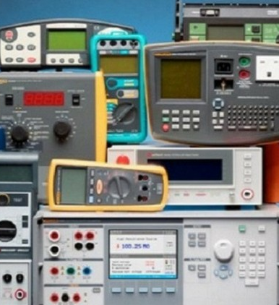

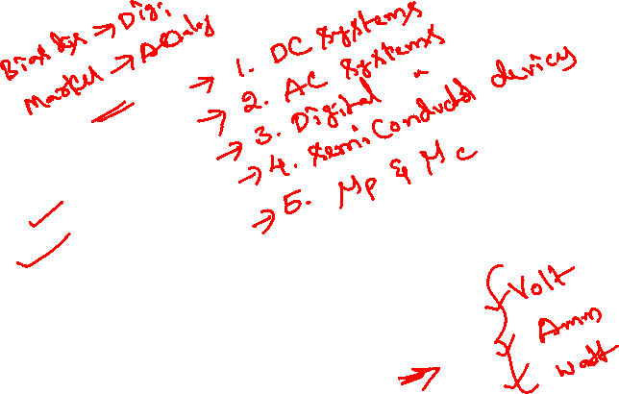
Measurements and instrumentation
Module 6

Slide 2
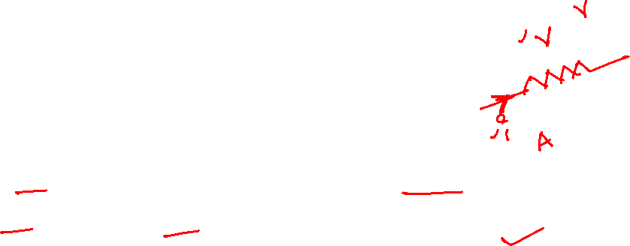
MEASURING INSTRUMENTS
“The device used for comparing the unknown quantity with the unit of measurement or standard quantity is called a Measuring Instrument.”
OR
“An instrument may be defined as a machine or system which is designed to maintain functional relationship between prescribed properties of physical variables & could include means of communication to human observer.”

Slide 3


1. Classification of Instruments

Slide 4

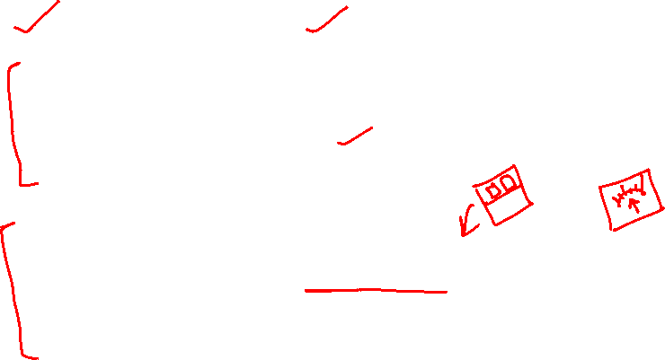
Classification of Instruments
a) Absolute instruments b) Secondary instruments
Absolute instruments
Gives the magnitude of the quantity under measurement in terms of physical constants of the instrument.
Ex: Tangent galvanometer
Secondary instruments
Instruments are so constructed that the quantity being measured can be measured by observing the output indicated by instrument. These instruments are calibrated by comparison with absolute instrument
Ex: Voltmeter, thermometer

Slide 5

Comparison
Absolute instruments
Secondary instruments
Gives magnitude of measurand in of physical constant
Time consuming
Standard instruments
Gives measurand value by terms indication directly.
Less time consuming
Calibrated with absolute instruments

Slide 6
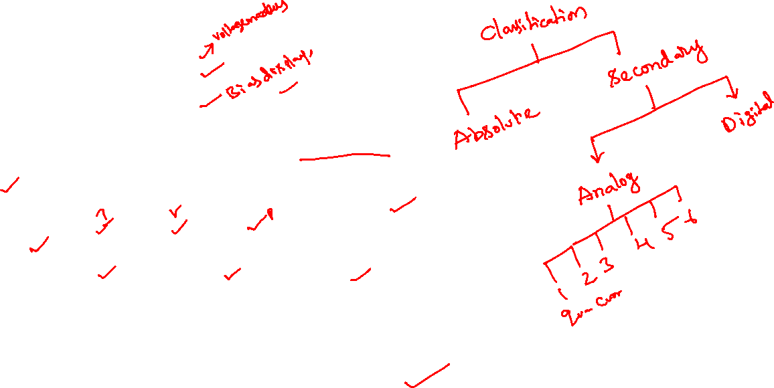
Classification of secondary instruments
a) Analog instruments
b) Digital instruments
Analog instruments
Output of the device is a continuous function of time.
Classification of Analog instruments
(1) Classified according to quantity they measure
Ex. Ammeter, Voltmeter, Wattmeter etc.
(2) Classified according to kind of current that can be measurand
Ex. Direct current, Alternating current, both AC and DC

Slide 7
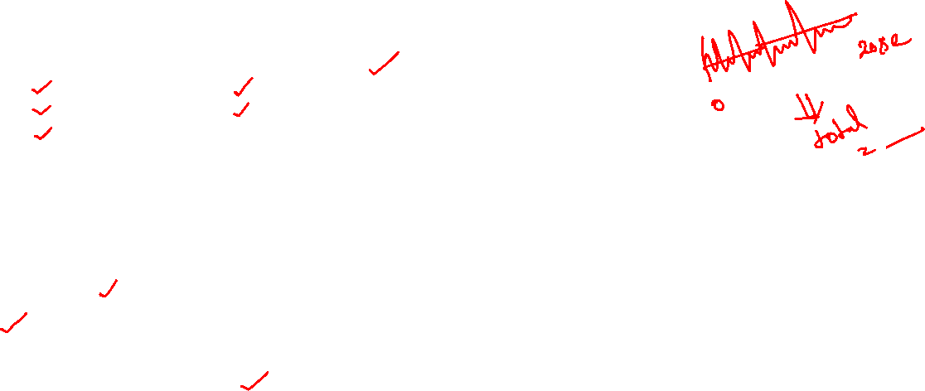
Classification of ANALOG instruments
(3) Classified according to way the output is presented to the user
Indicating instruments
Recording instruments
Integrating instruments
Indicating instruments: Indicate the magnitude of quantity being measured by a pointer and dial set up or by digital display.
Ex. Ammeter
Recording instruments: Continuous record of quantity being measured over a specified period of time.
Ex. ECG
Integrating instruments: Totalize or summarize events over a specified period of time. The summation which they give is the product of time and an electrical quantity
Ex. Amphour meter, Energy meter

Slide 8

Classification of analog instruments
4) Classified according to method used for comparison
Direct measuring
Comparison
Direct measuring: Converts energy of measurand directly into energy that actuates the instrument and value is measured directly. Ex: Ammeter
Comparison instruments: Measure unknown quantity by comparison with standard
(i) Direct comparison method: In this method the parameter to be measured is directly compared with either a primary standard or a secondary standard Ex – measurement of length,
(ii) Indirect method: In this method the comparison is done with a standard through use of a calibrated system. This is done when the parameter to be measured is difficult to be measured directly, but it has got some correlation with some other parameter which can be easily measured.
Ex. Elimination of bacteria in milk is directly dependent upon its temperature. Thus the bacteria elimination can be measured indirectly by measuring the temperature of milk

Slide 9
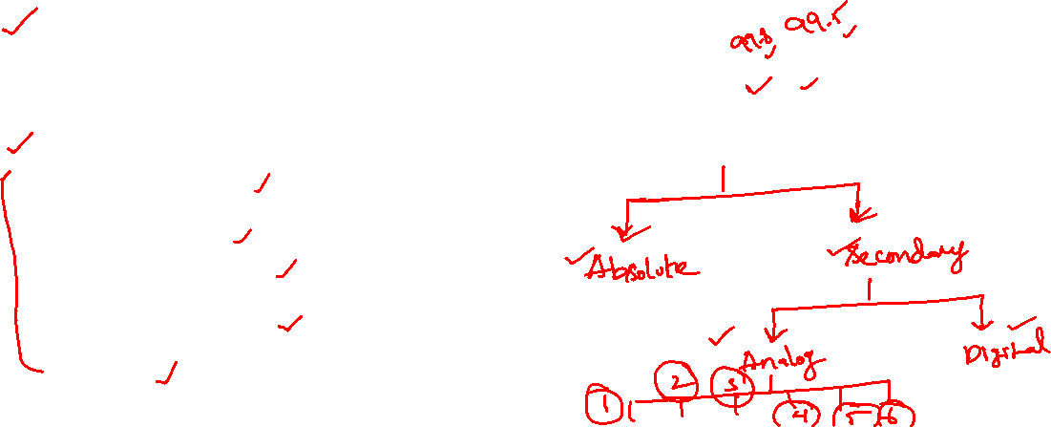
Classification of analog instruments
5) Classified according to their accuracy class
Accuracy class 0.2, 0.5, 1.0 etc means limiting error is ±0.2 ±0.5 ±1.0 respectively
6) Classified according to which of the effects is used for working
a) Magnetic effect
b) Heating effect
c) Electrostatic effect
d) Electromagnetic effect
e) Hall effect

Slide 10

Classification of Instruments
Absolute instruments
Secondary instruments
Digital instruments
Analog instruments
Classified according to quantity they measure
Classified according to kind of current that can be measurand
Classified according to way the output is presented to the user
Indicating instruments
Recording instruments
Integrating instruments
Classified according to method used for comparison
Direct measuring
Comparison
Classified according to their accuracy class
Classified according to which of the effects is used for working

Slide 11

2. Working principle of PMMC
PMMC - Permanent Magnet Moving Coil

Slide 12
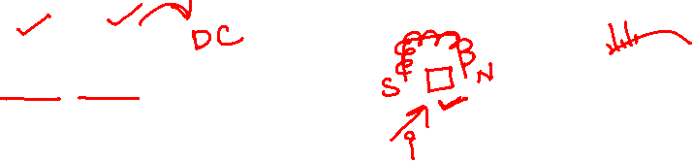
WHAT IS A PMMC?
The permanent magnet moving coil instruments are most accurate type for direct current measurements.
The action of these instruments is based on the motoring principle.
When a current carrying coil is placed in the magnetic field produced by permanent magnet, the coil experiences a force and moves.
As the coil is moving and the magnet is permanent, the instrument is called permanent magnet moving coil instrument.
This basic principle is called D’Arsonval principle.
The amount of force experienced by the coil is proportional to the current passing through the coil.

Slide 13
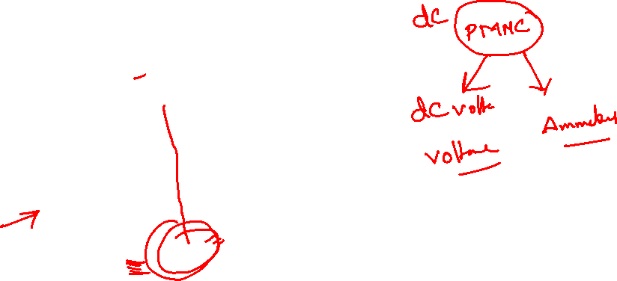
PMMC - Permanent Magnet Moving Coil

Slide 14
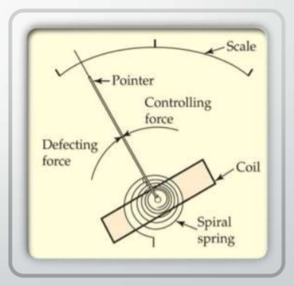
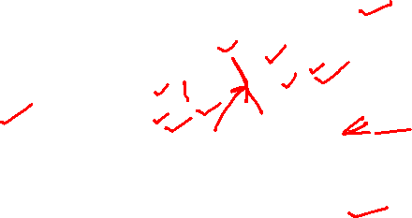
WORKING PRINCIPLE OF PMMC
When a current flow through the coil, it generates a magnetic field which is proportional to the current in case of an ammeter.
The deflecting torque is produced by the electromagnetic action of the current in the coil and the magnetic field.
When the torques are balanced with the help of a spring the moving coil will stopped and its angular deflection represent the amount of electrical current to be measured against a fixed reference, called a scale.
If the permanent magnet field is uniform and the spring linear, then the pointer deflection is also linear.
The controlling torque is provided by either one or two coiled helical springs.
These springs serve as a flexible connection to the coil conductors.

Slide 15
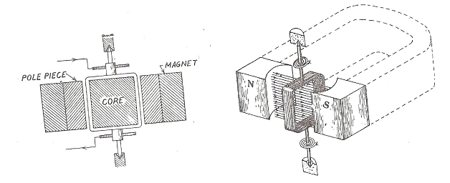
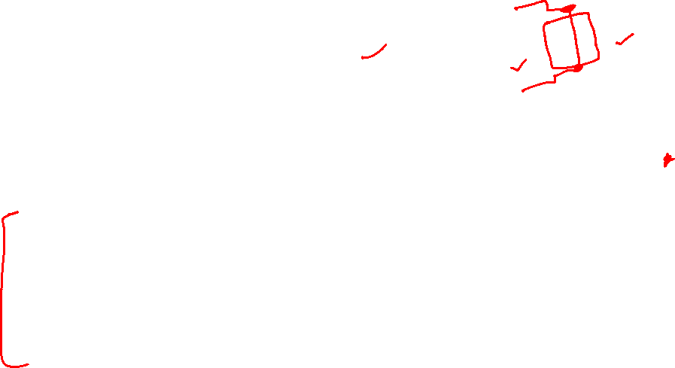
PMMC Overview
Most accurate type of dc instruments
Frequently used as substandard
Designed for full scale deflection current ranging from 5 μA to 20 mA
Principle
When the current to be measured (or current proportional to voltage to be measured) is passed through the coil placed in the uniform magnetic field, it experiences a force which makes the coil to move.
The coil is placed in the former which in turn is attached to spindle. Hence the spindle moves which carries a pointer moving over a graduated scale to indicate the value.

Slide 16

Deflecting torque
The force acting on each conductor is
F = BIℓ Newtons
The deflecting torque per turn of coil is therefore
T_{d} = BIℓ x w (Nm)
If the number of turns in the coil is N then the total deflecting torque is
T_{d} = NBI(ℓ x w) Newton meter
T_{d} = NBI A, where A = (ℓ x w) = area of the coil
T_{d} = NBA I Newton meters

Slide 17

Control Torque
In PMMC instrument, the controlling torque is mostly supplied by two phosphor bronze hair springs.
As the springs also function as current lead to the coil, their current carrying capacity imposes limitation on the current passing through the coil.
For current ranges, usually above 20mA, a shunt is used to by-pass a fraction of current
Control torque offered by the spring is
Tc = Ebt³ θ

Slide 18
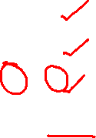
Damping Torque
The damping used in this type of instrument is mostly of eddy current type.
The eddy current is induced in the metal former of the coil which provides the necessary damping torque.
In addition, the bearing friction also provides damping torque.
AT STEADY STATE
T_{d} = Tc
Or I = Kθ
⇒ θ α I
So the scale is linear due to direct proportionality

Slide 19
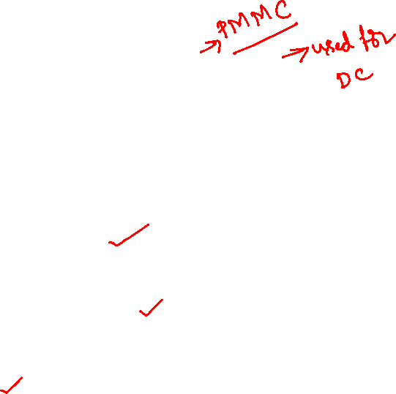
Advantages and Disadvantages
Advantages
Disadvantages
The PMMC consumes less power and has great accuracy.
It has uniformly divided scale and can cover arc of 270 degree.
The PMMC has a high torque to weight ratio.
It can be modified as ammeter or voltmeter with suitable resistance.
It has efficient damping characteristics and is not affected by stray magnetic field.
It produces no losses due to hysteresis
The moving coil instrument can only be used on D.C supply as the reversal of current produces reversal of torque on the coil.
It’s very delicate.
It’s costly as compared to moving coil iron instruments.
It may show error due to loss of magnetism of permanent magnet.

Slide 20

3. MI Instruments
MI – Moving Iron

Slide 21
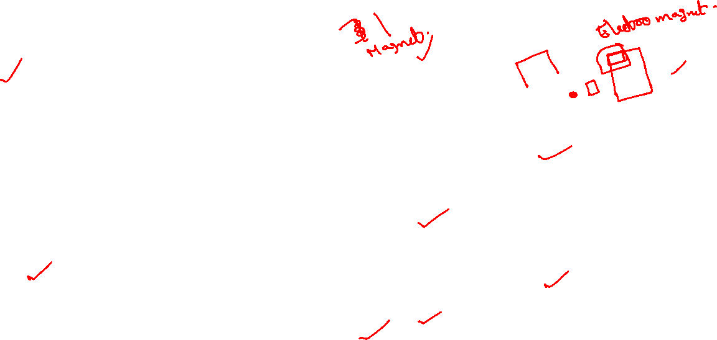
Moving iron instruments
Moving-iron instruments are generally used to measure alternating voltages and currents.
The instrument in which the moving iron is used for measuring the flow of current or voltage is known as the moving iron instrument.
It works on the principle that the iron place near the magnet attracts towards it.
The force of attraction depends on the strength of the magnet field.
The magnetic field induces by the electromagnet whose strength depends on the magnitude of the current passes through it.

Slide 22

Classification of the Moving Iron Instruments
The attraction and the repulsion are the types of the moving iron instruments.
Attraction Type
Repulsion Type

Slide 23
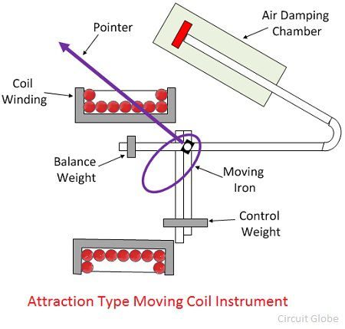

Attraction Type Instrument
The instrument in which the iron plate attracts from the weaker field towards the stronger field such type of instrument is known as the attraction type instrument.
Construction of Attraction Type Instrument
The stationary coil of the attraction type instrument is flat and has a narrow opening.
The moving element is the flat disc of the iron core.
The current flow through the stationary coil produced the magnetic field which attracts the iron coil.

Slide 24

Attraction Type Instrument
The iron vane deflects from the low magnetic field to the high magnetic field, and the strength of the deflection is directly proportional to the magnitude of the current flow through it.
In short, we can say that the iron coil attracts towards in.
The attraction type instruments use spring, which provided the controlling torque.
The deflection of the coil is reduced by the aluminium piston which is attached to the moving coil.

Slide 25
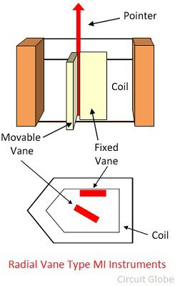
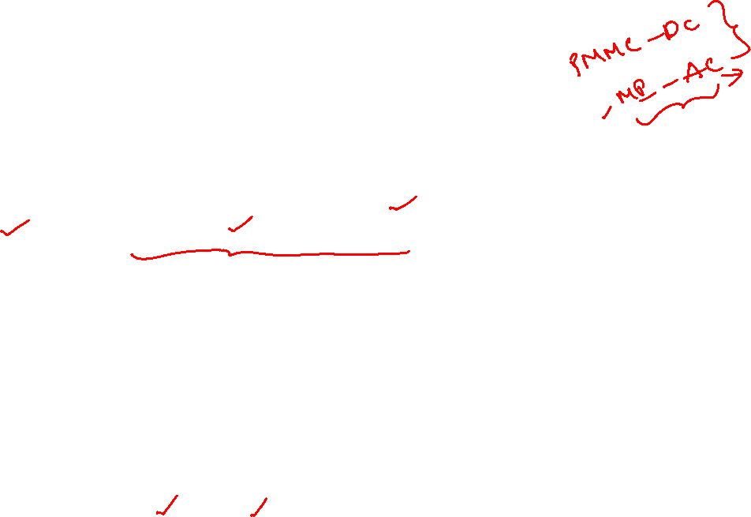
Repulsion Type Instruments
The repulsion type instrument has two vanes or iron plates.
One is fixed, and the other one is movable.
The vanes become magnetised when the current passes through the stationary coil and the force of repulsion occur between them.
Because of a repulsive force, the moving coil starts moving away from the fixed vane.
The spring provides the controlling torque.
The air friction induces the damping torque, which opposes the movement of the coil.
The repulsion type instrument is a non-polarized instrument, i.e., free from the direction of current passes through it.
Thus, it is used for both AC and DC.

Slide 26

Advantages of the MI Instruments
The following are the advantages of the moving iron instruments.
Universal use – The MI instrument is independent of the direction of current and hence used for both AC and DC.
Less Friction Error – The friction error is very less in the moving iron instrument because their torque weight ratio is high. The torque weight ratio is high because their current carrying part is stationary and the moving parts are lighter in weight.
Cheapness – The MI instruments require less number of turns as compared to PMMC instrument. Thus, it is cheaper.
Robustness – The instrument is robust because of their simple construction. And also because their current carrying part is stationary.

Slide 27
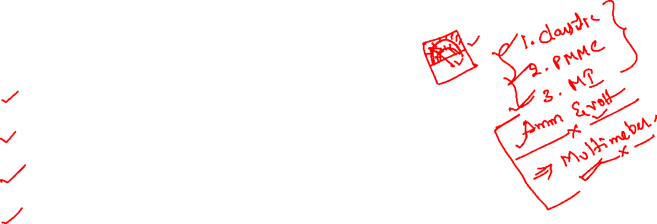
Disadvantages of Moving Iron Instruments
The following are the disadvantages of Moving Iron Instrument.
Accuracy – The scale of the moving iron instruments is not uniform, and hence the accurate result is not possible.
Errors – Some serious error occurs in the instruments because of the hysteresis, frequency and stray magnetic field.
Waveform Error – In MI instrument the deflection torque is not directly proportional to the square of the current. Because of which the waveforms error occurs in the instrument.
Difference between AC and DC calibration – The calibration of the AC and DC are differed because of the effect of the inductance of meter and the eddy current which is used on AC. The AC is calibrated on the frequency at which they use.
Two type of error occurs in the MI instruments i.e., the error which occurs on both AC and DC and the error which only occur on AC

